Slide 1

Grammatical Evolution and its Applications
Devinder Kaur

Slide 2
What is Grammatical Evolution????
Evolutionary Computation
applied to Grammar Template is called
Grammatical Evolution

Slide 3
Why Grammatical Evolution
Efficient, Adaptive and robust Search Processes, with a large amount of Implicit Parallelism
Few restrictions on model requirement; no need for differentiable functions.

Slide 4
Evolutionary Algorithm
Choose random initial population;
Repeat
  Evaluate fitness of individuals;
  Select pairs of best-ranking individuals to reproduce;
  Apply crossover operator;
  Apply mutation operator;
Until terminating condition

Slide 5
Two Applications are discussed
Fuzzy Classification of IRIS Dataset
Intrusion Detection Data set

Slide 6
Problem Definition
Construct a classification system to match the data set.
X1
Iris species system
. . .
Y
Xn
classification system
Y*
Desirable properties:
  Accurate predictions;
  Good explanatory capacity.

Slide 7
Structure Identification
Iris properties:
  Sepal Length;
  Sepal Width;
  Petal Length;
  Petal Width.
Iris Classes:
  Setosa;
  Versicolor;
  Virginica.

Slide 8
Fuzzy Partition of Sepal Length
Small
Small-Medium
Medium-Large
Large
1
Input variable “Sepal-Length”

Slide 9
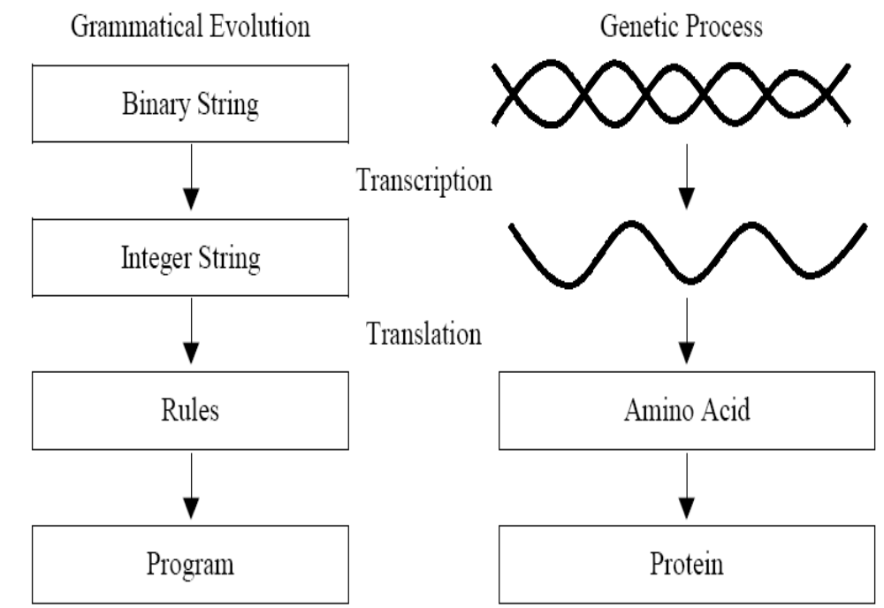
Grammatical Evolution (GE)

Slide 10
BNF(Backus Naur Form)
Example Grammar
Non-terminal = {statement, condition, function, variable, value}
Terminal = {x,y,a,b,c,d,f1,f2,f3,f4,f5 }
S = <statement>
Production rules:
<statement>::= IF <condition> <statement> Else <statement> END; (0)
| <function> (1)
<condition>::= (<variable> > <value>)
<variable>::= x (0)
| y (1)
<value> ::= a (0)
| b (1)
<function>::= f1 (0)
| f2 (1)
| f3 (2)

Slide 11
Example Mapping Sequence
01101000 01000100 00101100 11011000 …
104, 68, 44, 216, 17, 61, 123, 230,217, 71,250, 19, 62, 159, 122, 201, 123
Integer | Non-terminal | Rule
104 | <statement> | 104 MOD 2 = 0
IF <condition> <statement> Else <statement> END;
IF (< variable> > <value>) <statement> Else <statement> END;

Slide 12
Example translation sequence
104, 68, 44, 216, 17, 61, 123, 230,217, 71,250, 19, 62, 159, 122, 201, 123
Integer | Non-terminal | Rule
68 | <variable> | 68 MOD 2 = 0
<variable> ::=x
IF ( x > <value>) <statement> Else <statement> END;

Slide 13
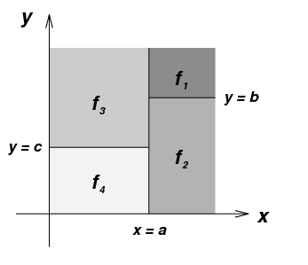
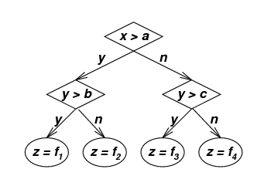
Fully derived code
IF(x>a)
IF(y>b)
(f1),
ELSE
(f2),
END;
ELSE
IF(y>c)
(f3),
ELSE
(f4),
END;
END;

Slide 14
Non_terminals = {<statement>,<ant>,<cons>}
Terminals = {Small, Small-Medium, Medium-Large, Large, Virginica, Setosa, Versicolour}
S = <statement>
P=
<statement> ::=
If (SL is <ant>) and (SW is <ant>) and (PL is <ant>)and (PW is <ant>) Then <cons>;
If (SL is <ant>) and (SW is <ant>) and (PL is <ant>)and (PW is <ant>) Then <cons>;
.
. (repeat n times for n rules)
.
If (SL is <ant>) and (SW is <ant>) and (PL is <ant>)and (PW is <ant>) Then <cons>;
<ant> ::= Small (0)
| Small-Medium (1)
|Medium-Large (2)
|Large (3)
|All (4)
<cons>::= Virginica (0)
|Setosa (1)
|Versicolour (2)

Slide 15
Mapping Sequence
01101000 01000100 00101100 11011000 …
104, 68, 44, 216, 17, 61, 123, 230,217, 71,250, 19, 62, 159, 122, 201, 123
Integer | Non-terminal | Rule
104 | <statement> | 104 MOD 5 = 4
If (SL is <ant>) and (SW is <ant>) and (PL is <ant>)and (PW is <ant>) Then <cons>; If (SL is <ant>) and (SW is <ant>) and (PL is <ant>)and (PW is <ant>) Then <cons>;
If (SL is “All”) and (SW is <ant>) and (PL is <ant>)and (PW is <ant>) Then <cons>; If (SL is <ant>) and (SW is <ant>) and (PL is <ant>)and (PW is <ant>) Then <cons>;

Slide 16
Mapping Sequence
01101000 01000100 00101100 11011000 …
104, 68, 44, 216, 17, 61, 123, 230,217, 71,250, 19, 62, 159, 122, 201, 123
Integer | Non-terminal | Rule
68 | <statement> | 68 MOD 5 = 3
If (SL is <ant>) and (SW is <ant>) and (PL is <ant>)and (PW is <ant>) Then <cons>; If (SL is <ant>) and (SW is <ant>) and (PL is <ant>)and (PW is <ant>) Then <cons>;
If (SL is “All”) and (SW is “Large”) and (PL is <ant>)and (PW is <ant>) Then <cons>; If (SL is <ant>) and (SW is <ant>) and (PL is <ant>)and (PW is <ant>) Then <cons>;

Slide 17
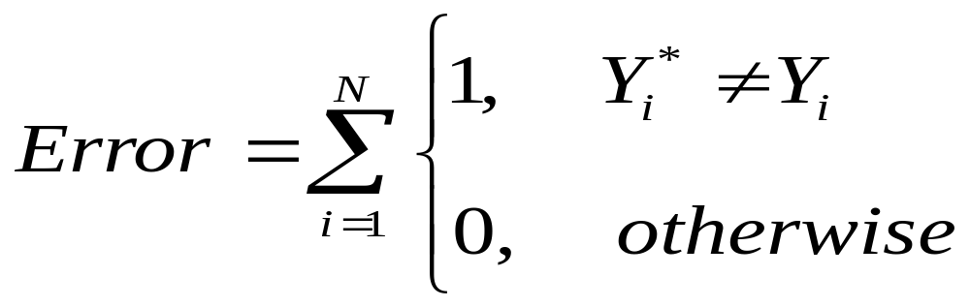
Fitness Evaluation
X1
Data from database
. . .
Y
Xn
GE Inference system
Y*

Slide 18
Fitness Evaluation
Binary Strings that determines program structure Fitness Values
01101100 01000100 00101100 10011000 … 2
11011010 00101101 10111001 10010110 … 7
01011000 01011100 00110101 10001010 … 14
.
.
.
.
.
.
00111010 00101101 10101100 11011000 … 106

Slide 19
Final Eight Rules Evolved
Rule# | Antecedent | Consequent
1 | If (Sepal-Length is Large) and (Petal-Length is Large) | Virginica
2 | If (Sepal-Length is Large) and (Petal-Length is Small-Medium)and (Petal-Width is Large) | Virginica
3 | If (Sepal-Length is Small) and (Sepal-Width is Medium-Large) and (Petal-Length is Small) | Setosa
4 | If (Petal-Length is Small) | Setosa
5 | If (Sepal-Length is Medium-Large) and (Petal-Length is Large)and (Petal-Width is Small-Medium) | Virginica
6 | If (Sepal-Length is Small-Medium) and (Sepal-Width is Small) and (Petal-Length is Medium -Large)and (Petal-Width is Large) | Virginica
7 | If (Sepal-Length is Small) and (Sepal-Width is Small-Medium) and (Petal-Length is Large)and (Petal-Width is Medium-Large) | Virginica
8 | If (Sepal-Width is Medium-Large) and (Petal-Length is Medium-Large)and (Petal-Width is Large) | Versicolour

Slide 20
Inference System
Fuzzy Classification Model
A1
X1
Π
Y1
A2
B1
Π
Y2
X2
B2

Slide 21
Mutation
01101000 01000100 00101100 11011000 …
104, 68, 44, 216, …
A1
X1
Π
Y1
A2
B1
Π
Y2
X2
B2
01101000 01000101 00101100 11011000 …
A1
104, 69, 44, 216, …
X1
Π
Y1
A2
B1
Π
Y2
X2
B2

Slide 22
Crossover
Parent:
01101000 01000100 00101100 11011000 …
104, 68, 44, 216, …
11011010 00101101 10111001 10010110 …
Crossover point
Children:
01101000 01000100 00111001 10010110 …
104, 68, 115, 150, …
11011010 00101101 10101100 11011000 …

Slide 23
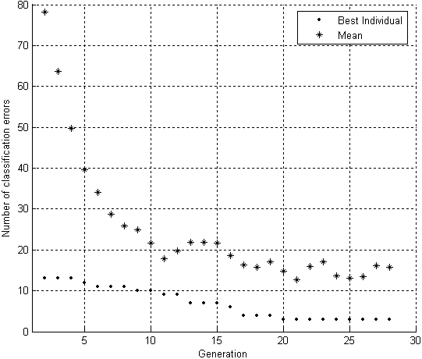
Implementation details
  Population size: 100;
  Mutation rate: 0.005 to 0.02;
  Crossover rate: 0.8 (single point);
  Termination condition: 50 generations;
Mutation rate | single | double | scattered
0.005 | 97.8 | 97.3 | 97.5
0.01 | 97.6 | 97.2 | 97.7
0.015 | 97.7 | 97.3 | 97.3
0.02 | 97.5 | 97.6 | 97.8

Slide 24
Conclusion
GE gives accurate classification using small number of rules.
Not prone to local minima.
Resulting model is in executable form.

Slide 25
Part II
Grammatical Evolution for
Intrusion Detection Intrusion Detection

Slide 26
GE Procedure for intrusion detection
Create initial population of random binary strings
Convert each string to a SQL statement using a grammar
Evaluate fitness of each SQL statement
Terminating condition met?
Yes
Done
No
Select pairs of best-ranking strings to reproduce
Apply crossover
Apply mutation

Slide 27
KDD Dataset
Unofficial standard for ID evaluation.
KDD records have 41 features.
Data is in preprocessed form with four kinds of features:
  Basic Features
  Content Features
  Time-based features
  Host-based features

Slide 28
Feature Subsets in KDD Dataset
Basic or Intrinsic Features
  common features to every network connection like duration of connection, service requested, bytes transferred between source and destination machine etc.
Content Features
  These features were collected by using domain knowledge of U2R and R2L attacks since these attack categories did not contain any frequently occurring patterns. E.g. logged in flag, number of failed logins, number of root commands, number of compromised conditions, etc.

Slide 29
Attack Categories
Probing
  Attacks that can automatically scan a network of computers to gather information or find known vulnerabilities.
Denial of Service (DoS)
  Excessive consumption of resources that denies legitimate requests from legal users on the system.
User to Root (U2R)
  Successful execution of attacks results in normal user getting root privileges.
Remote to Local (R2L)
  Attacker having no account gains a legal user account on the victim machine by sending packets over the network.

Slide 30
Input Features of Intrusion Dataset(41 features)
Variable name | Variable type
Duration | continuous
protocol type | discrete
service | discrete
flag | discrete
src bytes | continuous
dst bytes | continuous
land | discrete
wrong fragment | continuous
urgent | continuous
hot | continuous
num failed logins | continuous
logged in | discrete
num compromised | continuous

Slide 31
Input dimension reduction
All input variables are represented initially in the random population.
Input dimensionality reduction is done by the evolutionary process. Chromosomes with Input parameters that are not useful in predicting the output class are given low fitness so they are reduced in subsequent generations.

Slide 32
Initial Population of random binary strings
P=300(initial Population) | Strings (length = 128)
Chromosome 1 Chromosome 2 . . . Chromosome P | 01101000 01000100 00101100 11011000 …1 10011100 10110100 10110001 01010110 …0 . . . 101101001 0101110 01010100 01001011 …1

Slide 33
Example Grammar
N = {statement, condition, function, variable, value}
T = {x,y,a,b,c,d,f1,f2,f3,f4,f5 }
S = <statement>
Production rules:
<statement>::= IF <condition> <statement> Else <statement> END; (0)
| <function> (1)
<condition>::= (<variable> > <value>)
<variable>::= x (0)
| y (1)
<value> ::= a (0)
| b (1)
| c (2)
| d (3)
<function>::= f1 (0)
| f2 (1)
| f3 (2)
| f4 (3)
| f5 (4)

Slide 34
Example Conversion using grammar
104, 68, 44, 216, 17, 61, 123, 232,217, 73,250, 19, 62, 159, 122, 201, 123
Integer | N | Rule
104 | <statement> | 104 MOD 2 = 0
IF <condition> <statement> Else <statement> END;
IF (< variable> > <value>) <statement> Else <statement> END;

Slide 35
Example Conversion using grammar
104, 68, 44, 216, 17, 61, 123, 232,217, 73,250, 19, 62, 159, 122, 201, 123
Integer | N | Rule
68 | <variable> | 68 MOD 2 = 0
<variable> ::=x
IF ( x > <value>) <statement> Else <statement> END;

Slide 36


Fitness measure
We use a similarity measure for fitness. The closer the query generated by
a chromosome is to an output class the fitter the chromosome.
Selection of individuals for the next generation is probabilistic and is proportional
To the fitness of the individual. eg for:
    SELECT Count(*) FROM kdd_data
    WHERE (((protocol_type <> 'udp')
    AND (serror_rate < 0.75))
    AND ((Class = Normal));

Slide 37
Fully derived code, equivalent tree and input space partitioning
IF(x>a)
IF(y>b)
(f1),
ELSE
(f2),
END
ELSE
IF(y>c)
(f3),
ELSE
(f4),
END;,
END;
All are equivalent
01101000 01000100 00101100 11011000 …

Slide 38
Classification accuracy
Termination condition: 30 generations;
Mutation rate: 0.01;
Crossover rate: 0.8;
Class | Training Data Accuracy (%) | Testing Data Accuracy (%)
Normal | 87.6 | 54.6
Dos | 96.2 | 96
Probe | 59.1 | 49.4
U2R | 45.6 | 31
R2L | 23.6 | 1.4

Slide 39
Conclusion Contd.
The potential for developing intrusion system rules using Grammatical Evolution is demonstrated. The GE method is a form of symbolic regression and can work with both continuous and discrete input attributes without any assumption that the discrete values form a continuum.
The accuracy is higher among the Denial of Service and Normal classes which form a large proportion of the training dataset (79.2% and 19.7% respectively). As with many other results reported the attacks involving content (ie U2R and R2L), show low detection rates.
The current work is limited to finding the single hypercube of attribute properties which best infers a class. We are looking at extending this work into a union of hypercubes such that non-linear separation into classes can be better achieved. Further work will also include the development of hierarchical rule based intrusion detection systems using GE.

Slide 40
Thanks

